Slide 1
Physics of Noble Materials
ChiefGuest/President: Professor Dr.
APJ Abdul Kalam
Physicist and Nuclear Scientist
11th President of the Republic of India
18 October 2014 | sg@MCCIbd.org
Bangabandhu International Conference Center - BICC
Presented by
Project Seldon Programs and the PRISM
Chief Scientist: Professor Dr. Barack Obama
Spokesman: Hasan Uz-Zaman, MDHSM@BUP

Slide 2
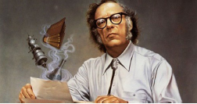
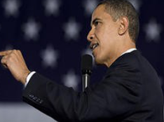
The Machine that Would Predict the Future
Physics of Noble Materials: The Life Simulation Device "Obama" of Commonwealth System; Wherever Commonwealth, Internet & Telecom System is the Life Simulation Platform and Obama, Computer & Mobile Phone is their Prime Radiant Devices.

Slide 3
Revelation of Psychohistory
Psychohistory! It is a new Branch of Mathematics, the term psychohistory was popularized by scientific writer Isaac Asimov for he is widely considered as father of Psychohistory.
Applied Psychohistory! When psychohistory is subject to application, it is appear as Branch of Physics.

Slide 4
Revelation of Psychohistory
Psychohistory work to measure the mass action of collective human behaviors to predict the general course of future flow.
Psychohistory is a mathematical study of future prediction, as same calculus is study of change, geometry is the study of shape, and algebra is the study of operations.
Psychohistory is a language to mathematical communication and program development for Prime Radiant Devices.

Slide 5
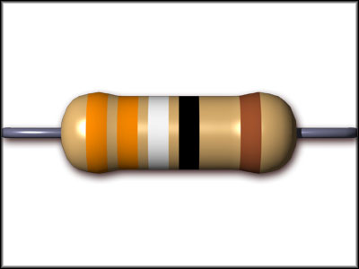
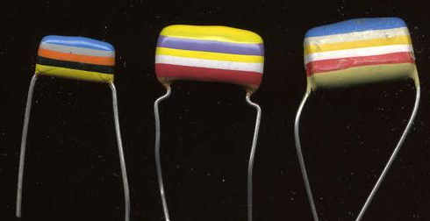
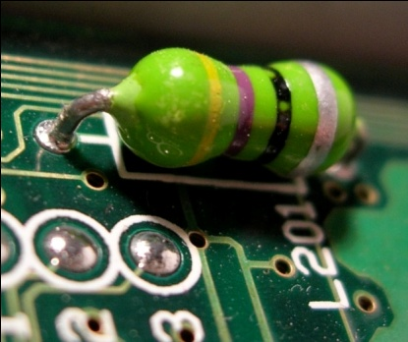
Color Coding to trace the Object, Action and the Future
Object: Electronic color code is used to recognize the values and ratings of electronic components, devices, and other elements, very commonly for Resistor, also for Capacitor, Inductor, and others. Separated color code also used to indentify wires in Telecommunication cables.

Slide 6
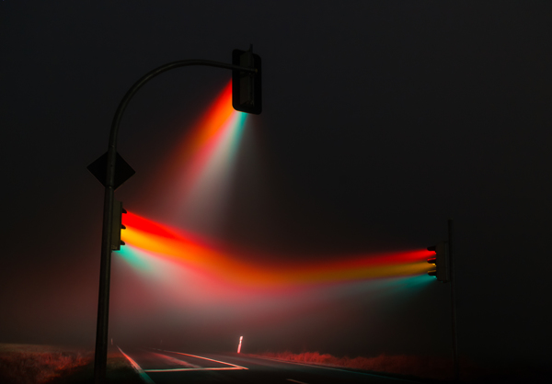
Color Coding to trace the Object, Action and the Future
Action: Traffic light signals are use color coding to deliver the message to action for very near future to rightly guided the highway sentient object. Most commonly used color is Red, Yellow, and Green on the Surface, Water, Air, and Space. Color code also use in the Espionage community to deliver the intelligent message and information in a short.

Slide 7
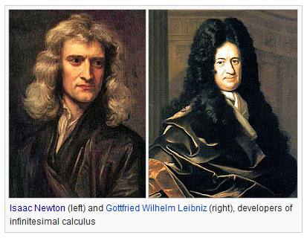
Color Coding to trace the Object, Action and the Future
Prediction: Color graph of Stoke Exchange and Forex Market hold the information of future economical flow. This color coding was not set by particular message. But user to predict the future market flow by observing color streaming on the graph. Prediction accuracy depend on user’s experience, and skill.

Slide 8
Color Equations
the Psychohistorical equations showing the future Development of Humanity. Prime Radiant device should appear it on the projection.
Following color-coding to equations within itself for ready comprehension by Psychohistorians:
01. Seldon Black or Obama Black
02. Speaker Red
03. Deviation Blue
04. Notation Green
05. Projection Purple
06. Red Square Kremlin
07. White House

Slide 9
Color Equations
1. Seldon Black- is the original Plan equations of future development and defined as Seldon Crises, the Plan's duration, and the yield of the Second and Third world.
2. Speaker Red- are additions to the plan and the another foundation of future developments. This convention is supposed; all men are like Grass, and all its Glory like the flower of Grass. The Grass withers and the Flower falls off; But Development of Humanity stands forever.
3. Deviation Blue- is observed deviations away from Psychohistorical projections with a deviation in excess of 1.5 standard deviation of predicted outcomes (1.5 σ). The Era of Deviations, at the rise of the Mule, produced deviations in the Seldon Plan in excess of 0.5 through 10 sigmas.
4. Notation Green- additions of pertinent scientific papers appended to findings.
5. Projection Purple- Useful for determining limits on future Speaker Red equations, using projections of events with regard to a very sketchy but still Seldon Black scheme include a tool of a number of generations of Psychohistorians.

Slide 10
Future Flow
When Quantum Mechanics and Kinetic theory are not capable to define characteristics of a single molecules in the chemical reaction but their mass characteristics. As such, Hydrogen (H) and Oxygen (O) produce Water (H2O). So, the product of a chemical reaction is predictable.
If we imagine to consider the human instead of the molecules. So, mass action of human behaviors is predictable that it will emerge a course of future flow of human civilization.

Slide 11
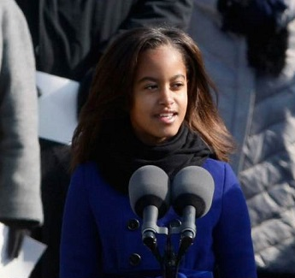
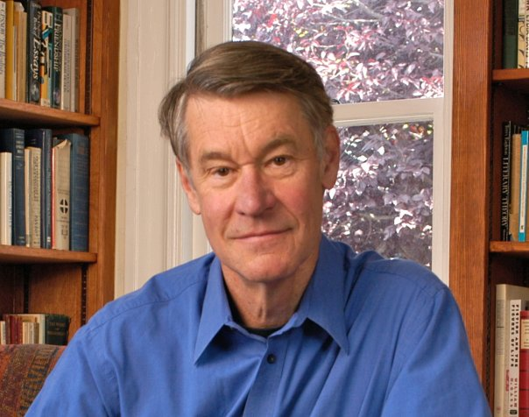
Prime Radiant Device and Equations
The Prime Radiant device belongs to a giant platform namely Commonwealth, as internet is simulated platform of web universe.
On the every step of entities, the equations show the information of Course, Bearings and Headings of future flow.
Once mathematical calculation done on simply with handwriting on the papers, there was no excel nor any software. Dit-Dah Morse Code was the beginning of radio and telecommunication.
Project Seldon deserve the equilibrium state of least prediction.

Slide 12
Background of Project Seldon Programs and the PRISM
When Isaac Asimov popularized the term Psychohistory in his foundation series and said that this is a news branch of mathematics. The mathematics is also subject to predict the general course of future flow. The world made sense on his concept. He designed the project proposal in literature form along with through many characters.
According to experience of research, this prediction is subject to consider that many a young and professionals have been dreaming to transmute the scientific project into the fact. So, the Project Seldon is appeared now.
Who has eyes to watch, watch. Ears to hear, hear. Interest to know, should be understood.

Slide 13
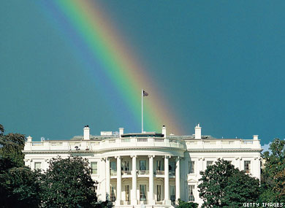
Project Seldon and the PRISM | Physics of Noble Materials Thanking You | Presentation END
Whenever I bring clouds over the earth and the Rainbow appears in the clouds, I will remember my covenant between me and you and all living creatures of every kind. Never again will the waters become a flood to destroy all life. So God said to Noah, "This is the sign of the covenant I have established between me and all life on the earth.“
Genesis 9:14-17

